Slide 1
Laboratorio de Tiempo y Frecuencia
/ Time and Frequency
Laboratory
2015 - 2017
Eng. Liz Catherine Hernández Forero
lhernandez@inm.gov.co
Physicist. Nelson Bahamón Cortés
nbahamon@inm.gov.co

Slide 2
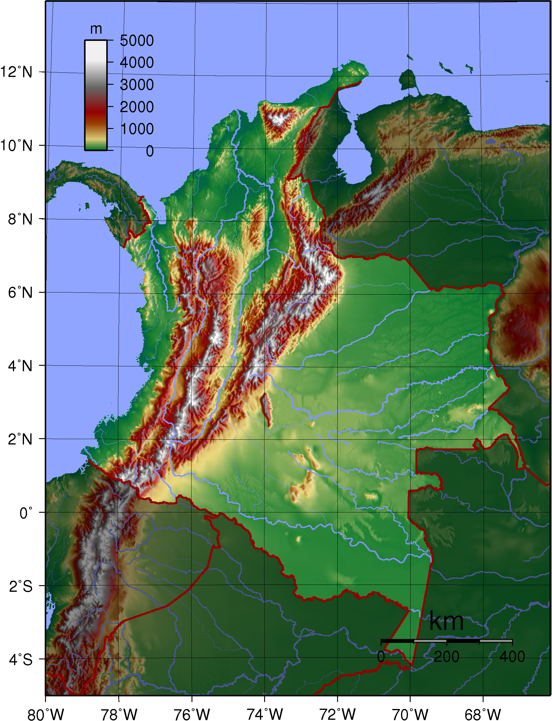
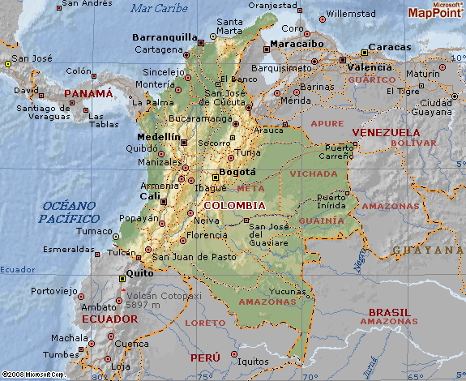

Slide 3
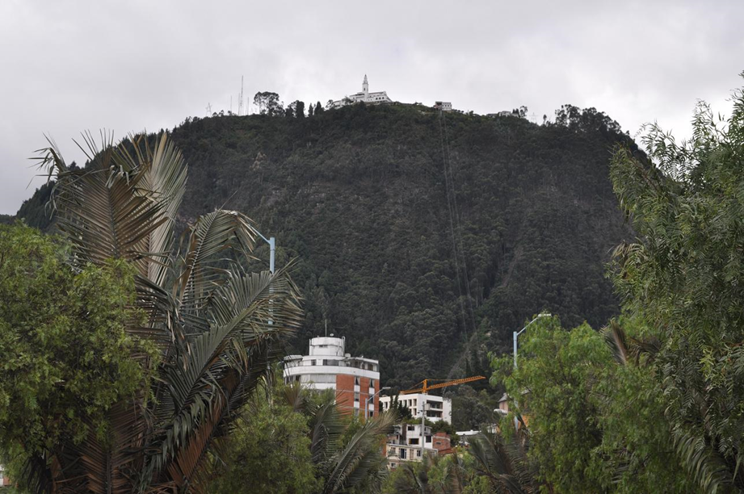

Slide 4
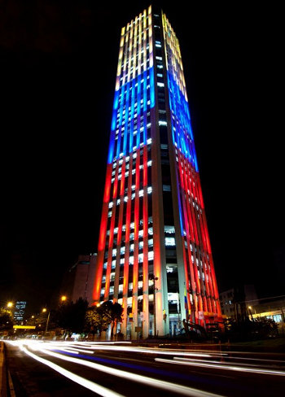
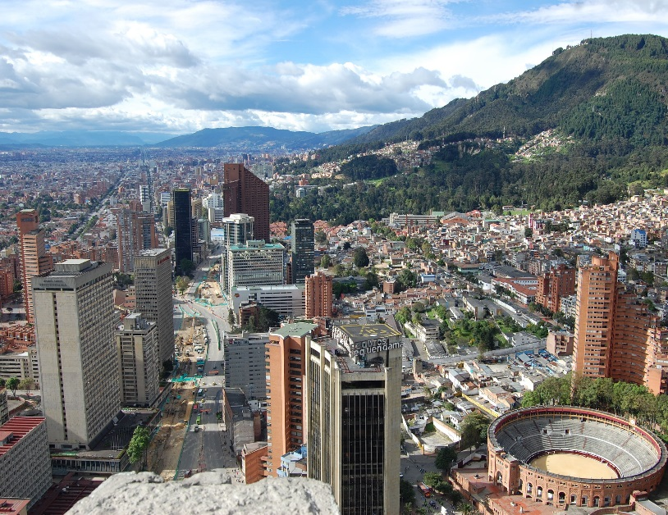

Slide 5
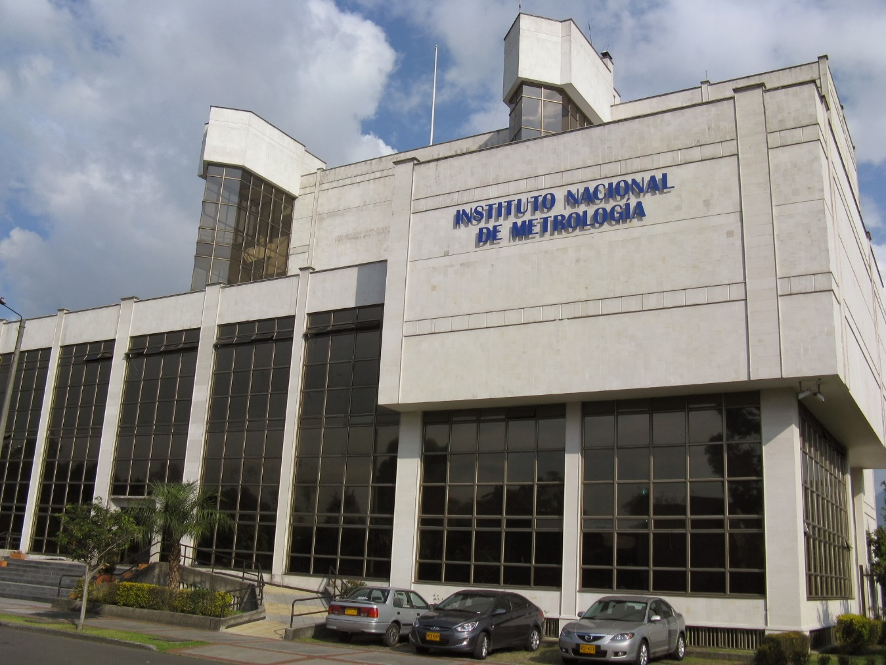

Slide 6
Before July - 2015

Slide 7
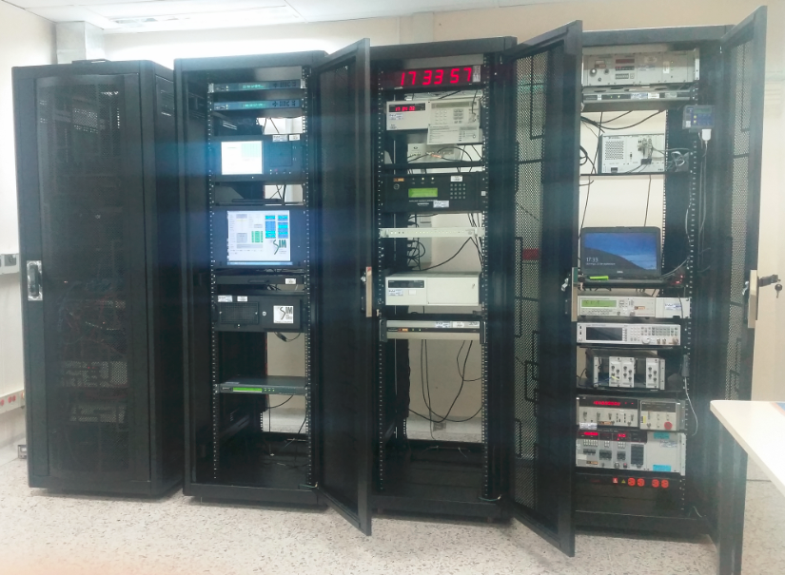
July - 2015
1. Primary Standards

Slide 8
July - 2015
2. Traceability

Slide 9
July - 2015
3. CMC
Calibration Services

Slide 10
July - 2015
3. Disseminate
“Legal Time” URL

Slide 11
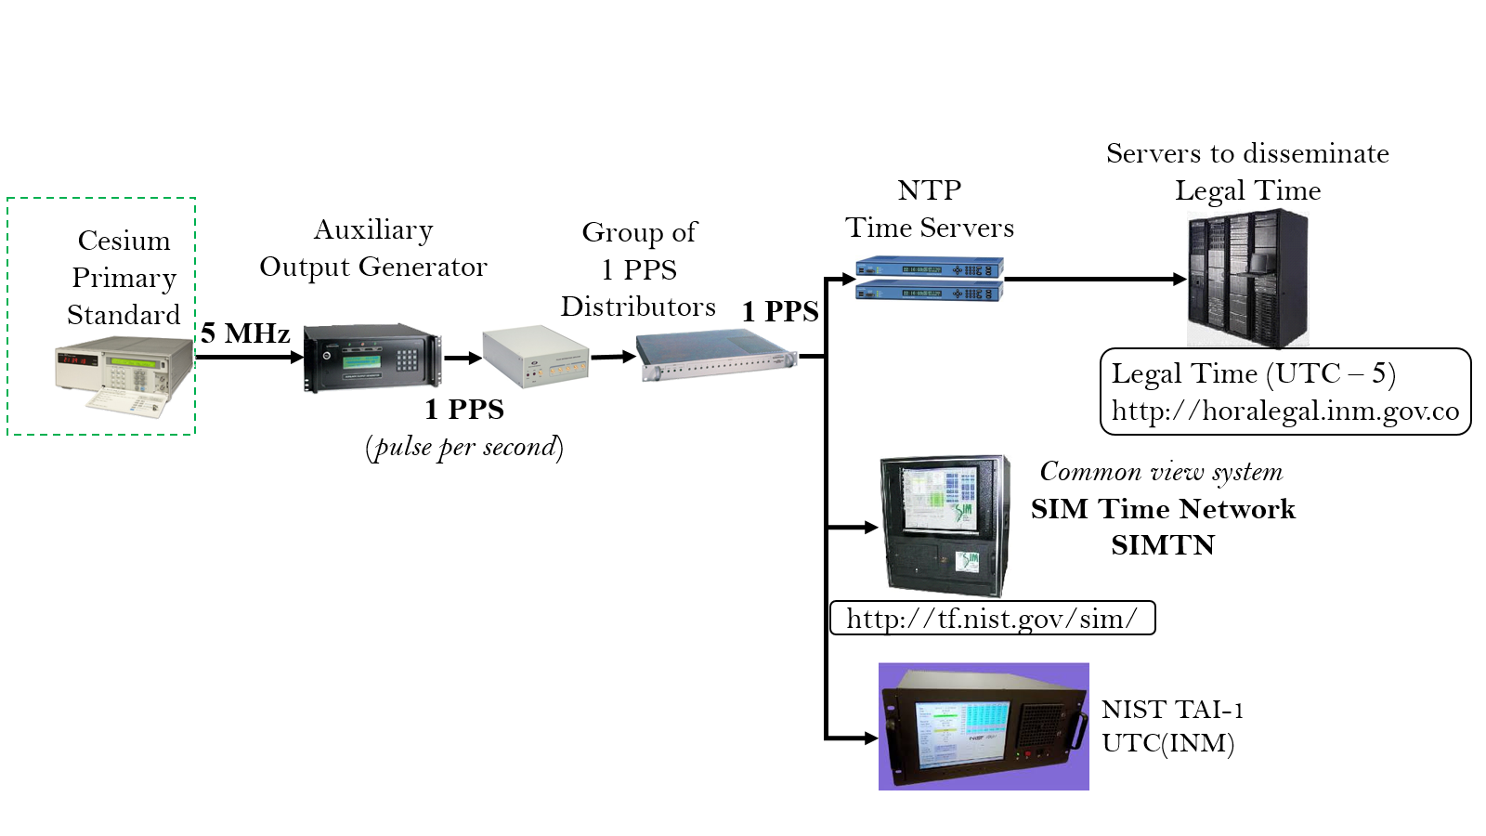
Actual
Traceability Scheme

Slide 12
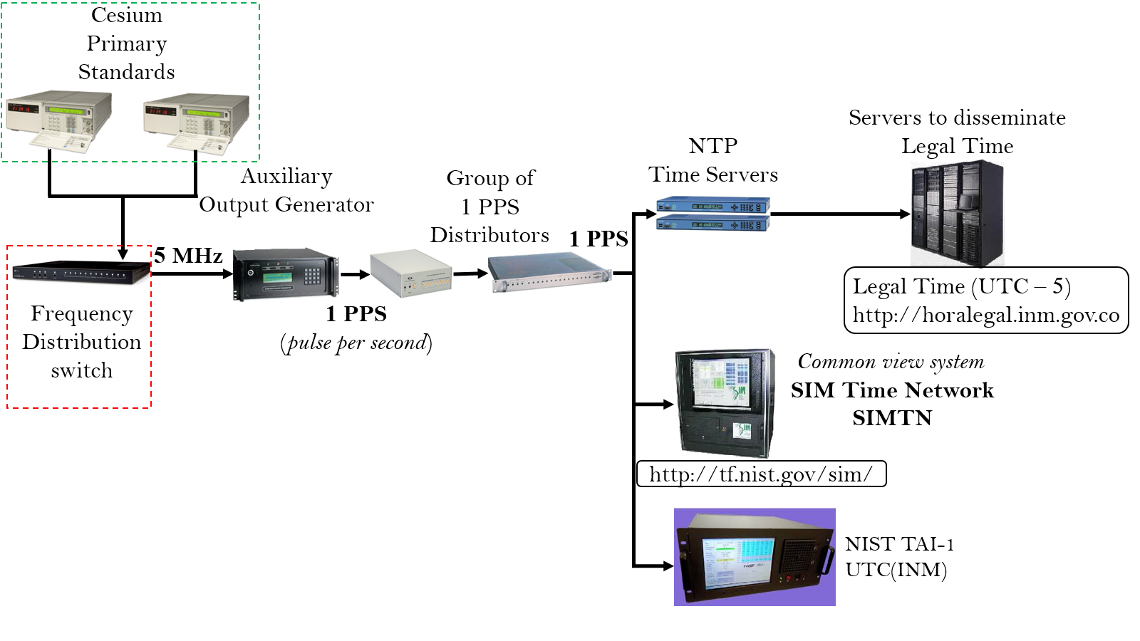
Future
Traceability Scheme

Slide 13
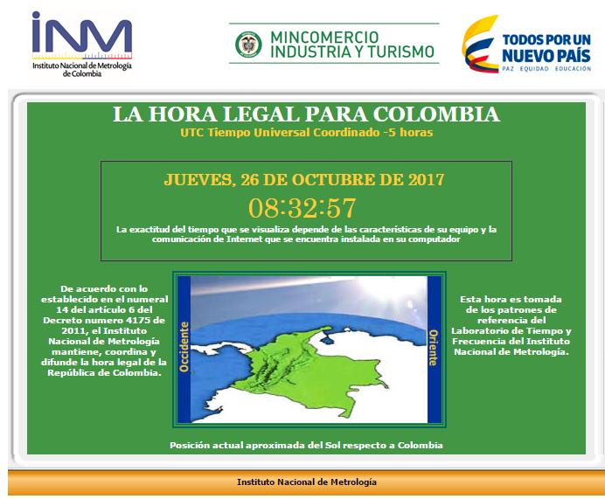
horalegal.inm.gov.co

Slide 14
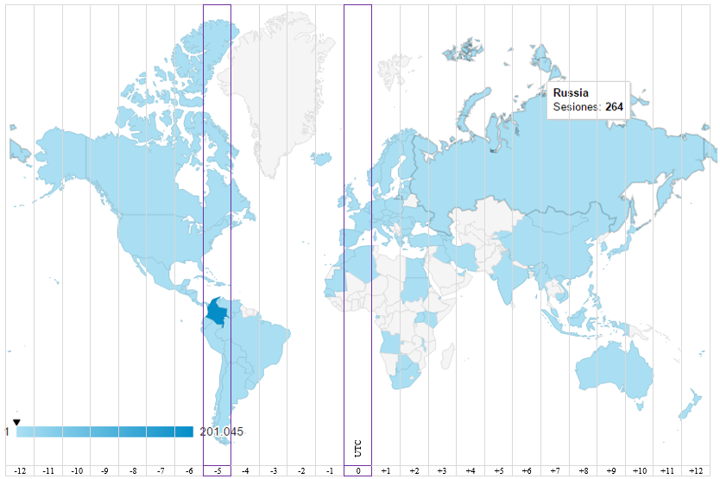
2016
# consultas por día en periodo de un año.

Slide 15
DATE | OBJECTIVE PROPOSED
2011 (SIC) to 2013 (INM) 2014, 2016 (Accreditation monitoring audits) | Accreditation
2013 | The Arrangement was signed
2014 to 2015

Slide 16
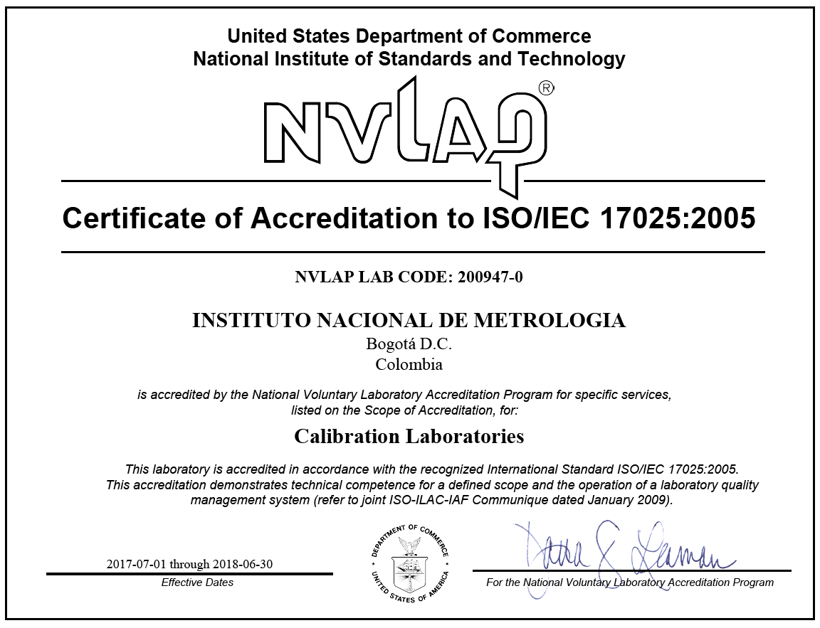
Accreditation Process

Slide 17
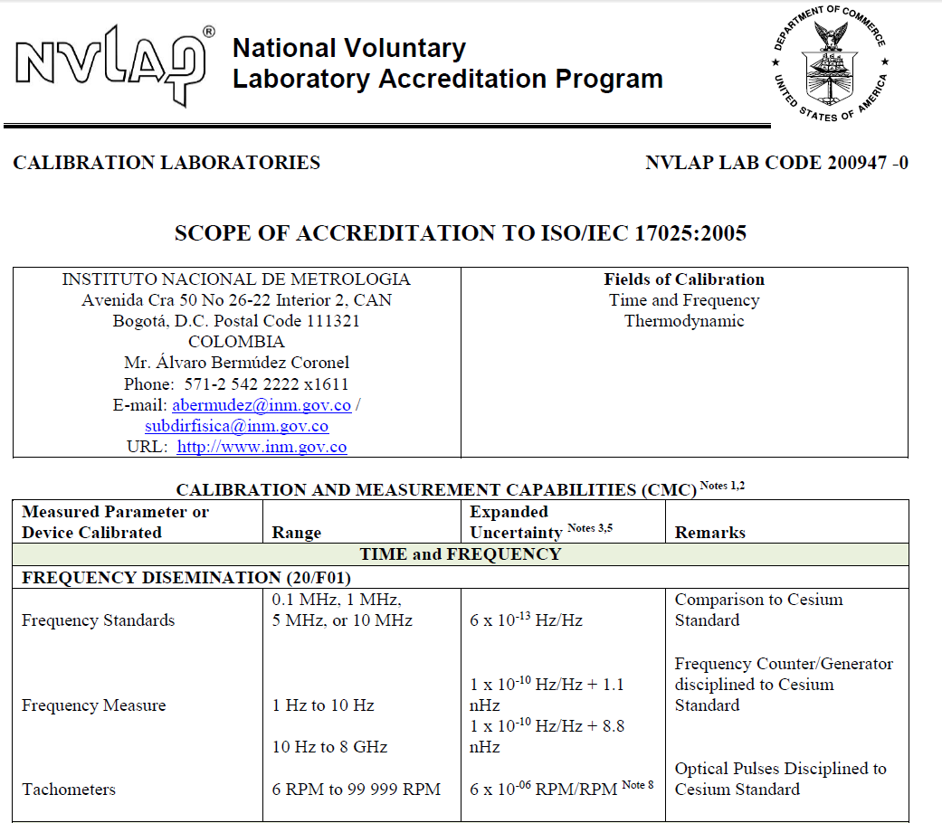
Trigger specification

Slide 19
Cooperation
21st meeting of the CCTF
8-9 June 2017
Representatives of Institutes from Member States invited to attend as Observers
[INM Colombia], Bogotá

Slide 20
DATE | OBJECTIVE PROPOSED
2011 (SIC) to 2013 (INM) 2014, 2016 (Accreditation monitoring audits) | Accreditation
2013 | The Arrangement was signed
2014 to 2015
2017 | ftp://ftp2.bipm.org/pub/tai//Circular-T/cirthtm/cirt.356.html

Slide 21
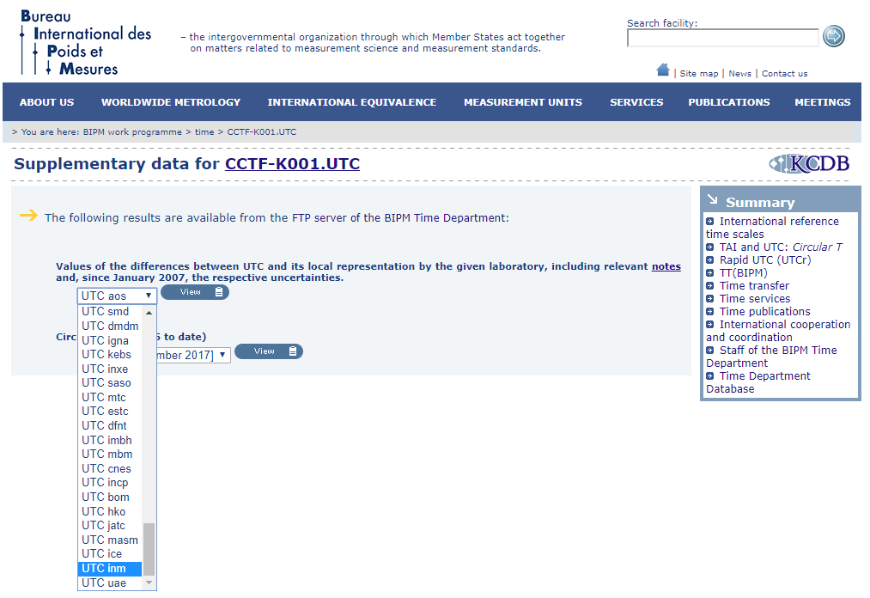

Slide 22
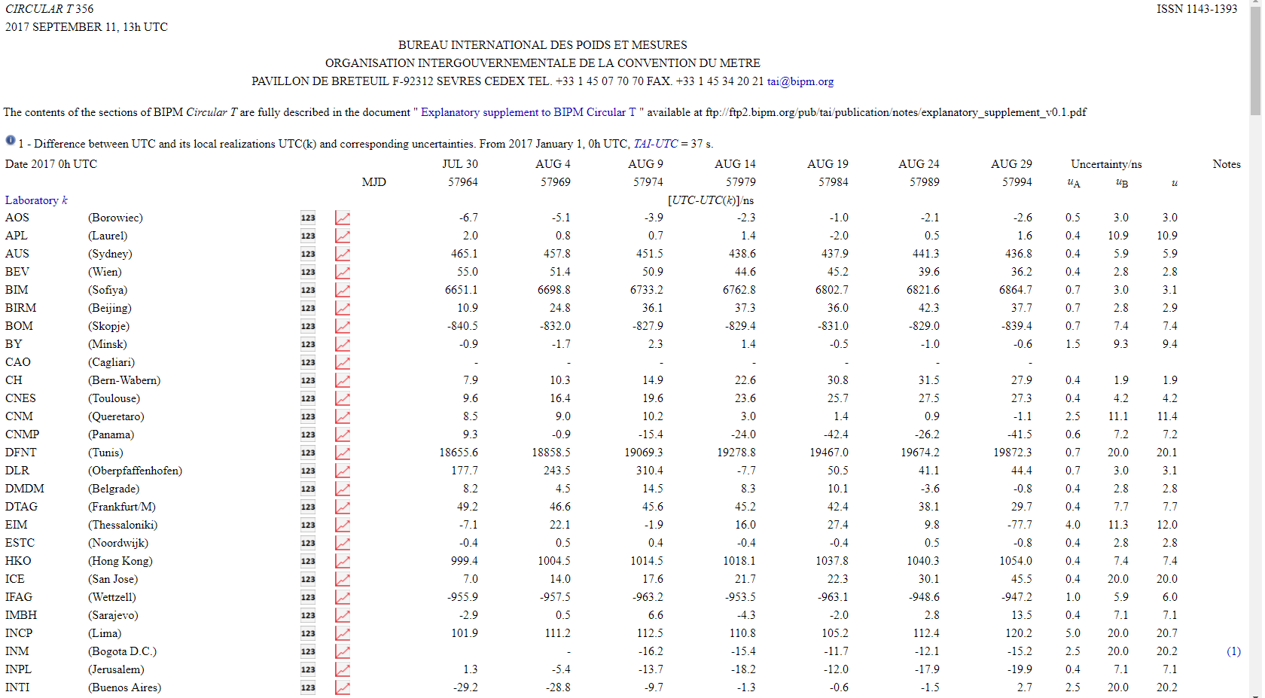

Slide 23
Publications

Slide 25
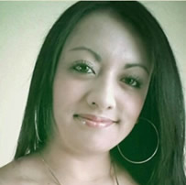
Madelen
Arenas

Slide 26
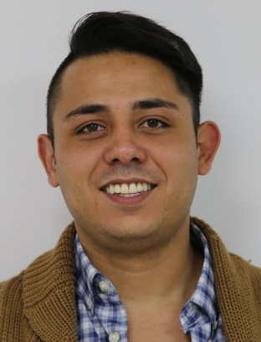
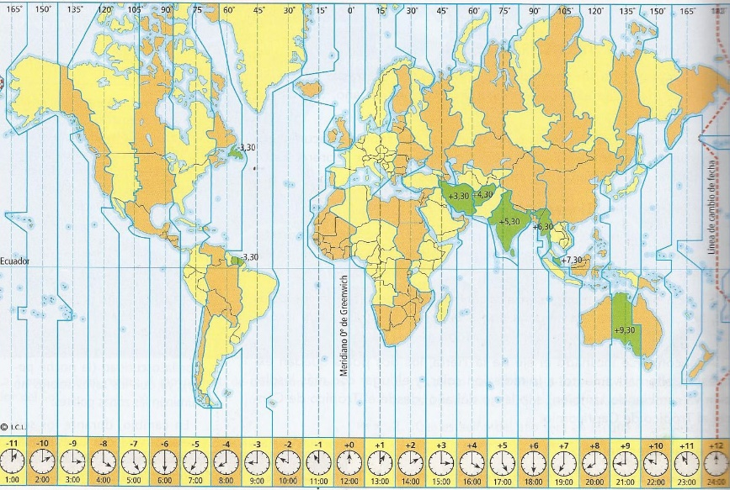
Ricardo
Casallas
Time zones

Slide 27
Publications

Slide 28
Publications
2016

Slide 29
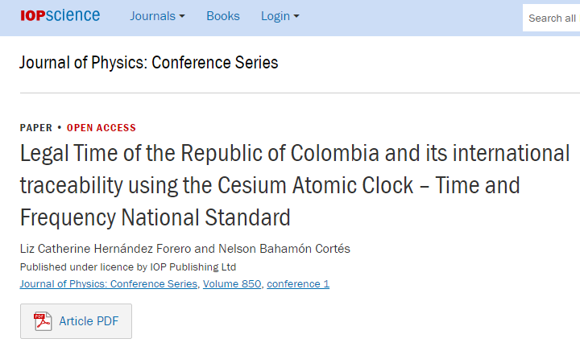
Publications
2017

Slide 30
Publications

Slide 31
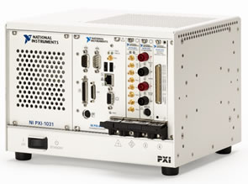
OBJECTIVE | ACTIVITIES
What is proposed to do? | Improve the automatization method with an additional validation process, related to acquisition in real time with a PXI.

Slide 32
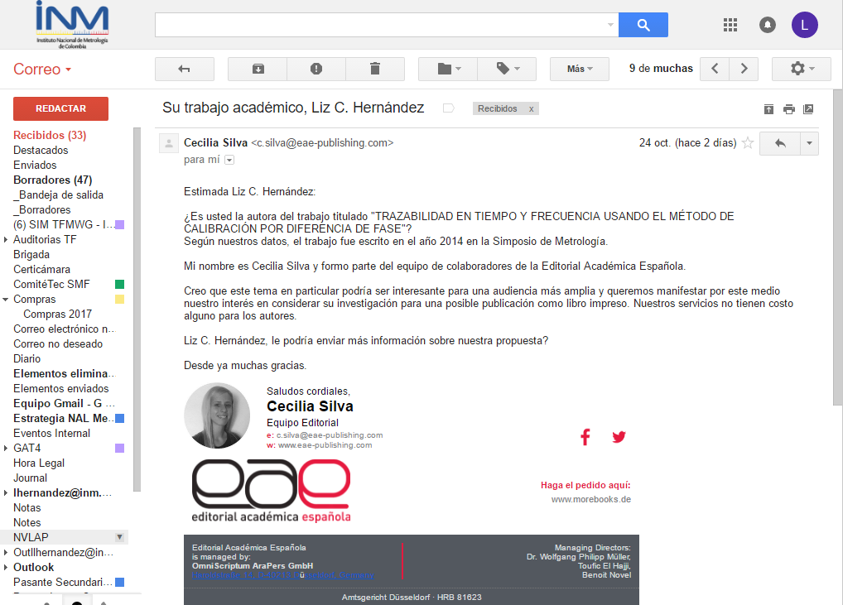

Slide 33
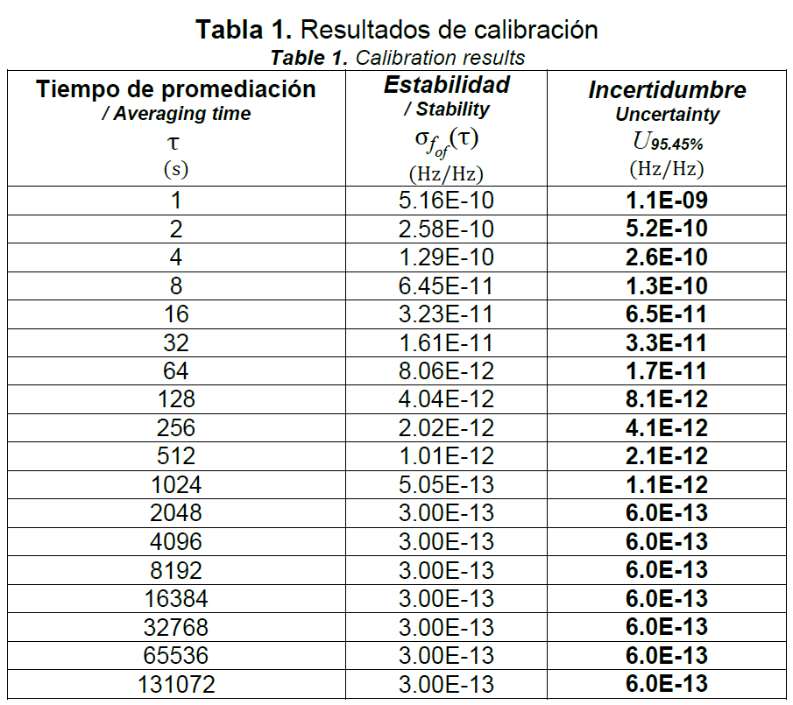
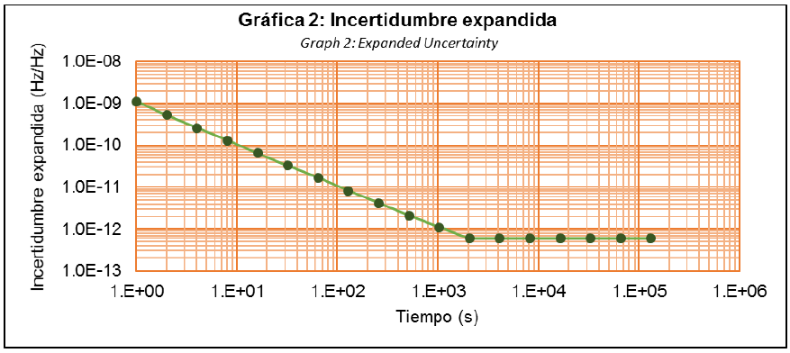
Future ?
Example of a CMC analysis
/

Slide 34
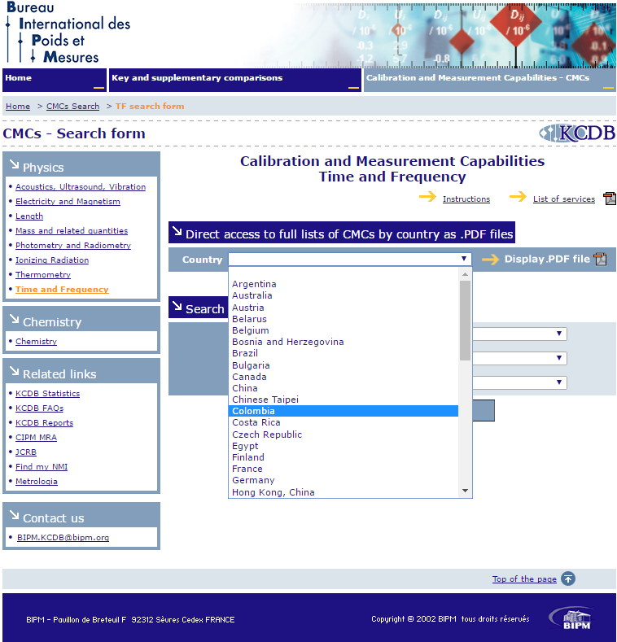

Slide 35
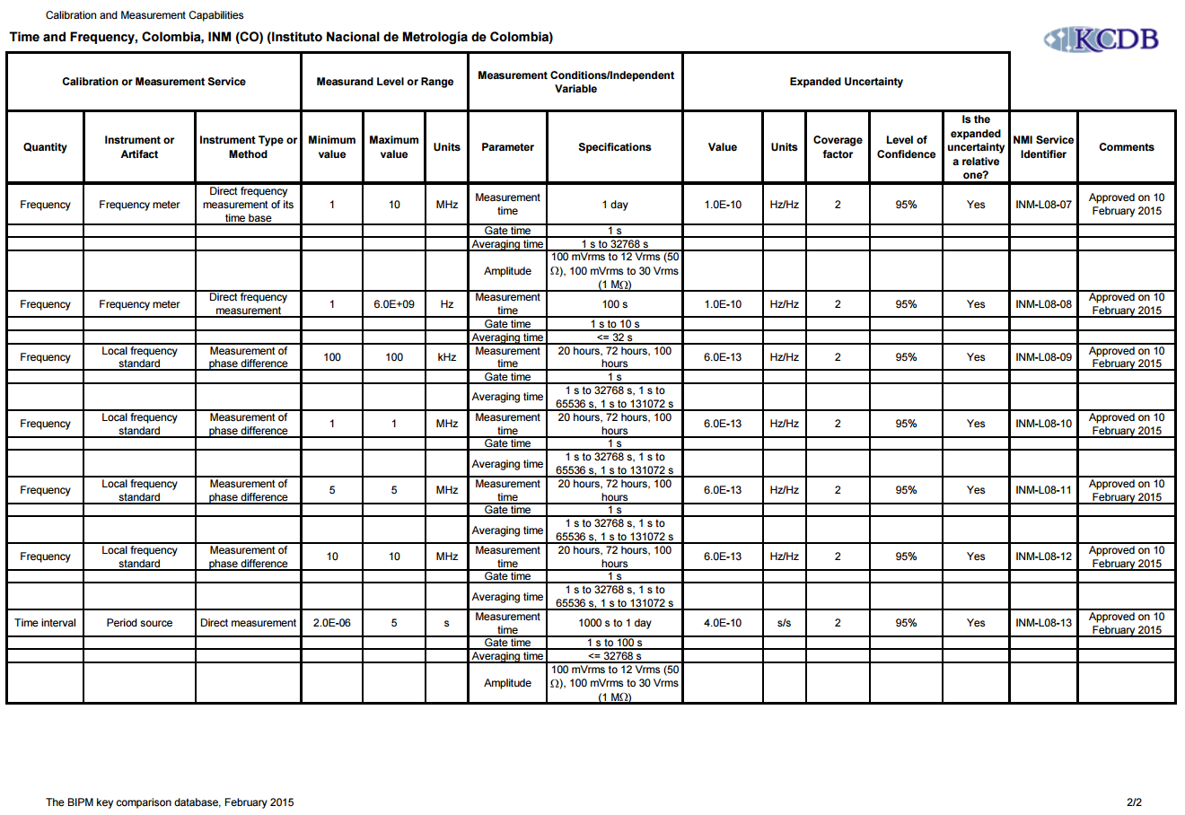
c)

Slide 36
Example CMC analysis

Slide 37
Future ?
Conclusion
Update the uncertainty budget.
Decrease numerical value of the published CMC.

Slide 38
Future ?
Conclusion
Improve contribution (%) to
Circular T ➔ UTC(INM)
SIMT ➔ SIMT(INM)

Slide 39
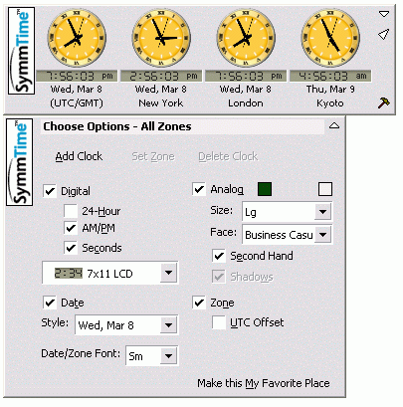
Future ?
Improve NTP
dissemination.

Slide 40
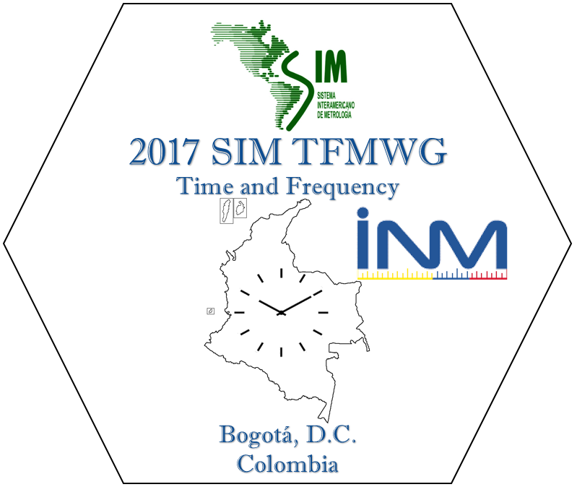
¡ Muchas Gracias !
Thank you very much !

